Slide 1

Title of the book
TECH 105 Introduction to Engineering Technology
Presented by: Joe Tabas
Notes:
Hello and welcome to my presentation of the book….(Book Title)
My name is Joe is Joe Tabas and today I will discussing the stories…(Story Titles)

Slide 2
PHASERS ON STUN
Phasers on Stun
I like this story as it opens up on the defects of some cancer therapy machines
Add several key points about the story
Ray Cox had gone for a cancer for radiation removal
The last time he visited the place concerned the removal of tumor
Mary Beth was the surgeon
Just as other surgeries had gone he expected the best but it never turned to be the case
Notes:
It is a story about an physiotherapy error that cost the life of Ray Cox
I choose the story because it opens up about serious incompetency and negligence of physiotherapists or doctors in general which resulted in a crisis
Ray Cox the patient at long last died after having a very bad treatment of constant errors and editing by his doctor Mary Beth.

Slide 3
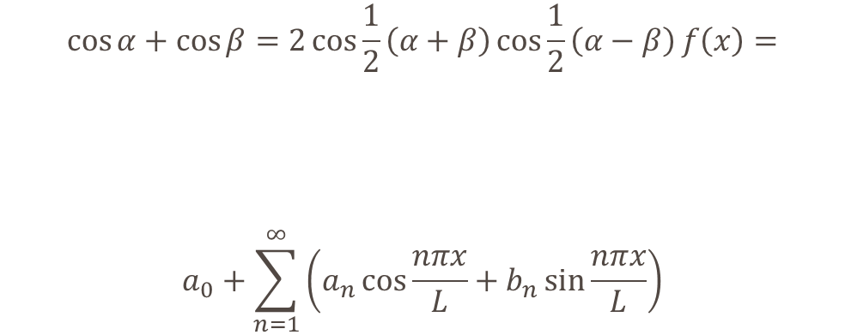
Use an Appropriate Title
What we now know is that…
There are several new technologies…
The body of scientific knowledge recently expanded providing new insight into …
$$\cos{α}+\cos{β}=2\cos{\frac{1}{2}\left(α+β\right)}\cos{\frac{1}{2}\left(α−β\right)}f\left(x\right)=$$
$$a_{0}+\sum_{n=1}^{∞}{\left(a_{n}\cos{\frac{nπx}{L}}+b_{n}\sin{\frac{nπx}{L}}\right)}$$
Notes:
The above story I have explained above can be related to the research I did sometimes back in which I applied the formula above hence it can also be applied here when it comes to the analysis of data

Slide 4
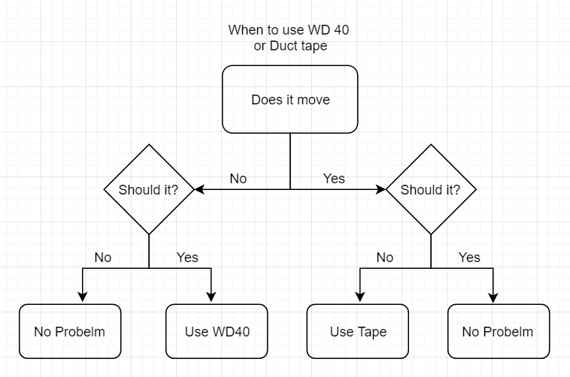
Add title
Notes:
Here is the process I used to begin my design process. As you can see, I needed to start with problem identification then I could determine if a problem existed and the best approach to solving it. This is the most important step because….

Slide 5
Phase 0 Concept Evaluation
Make a list of initial thoughts
First from the beginning of the story I thought the surgery will be successful
Mary Beth was an incompetent doctor
Mary Beth made several errors in the process although she thought she can just correct
The best way is for physiotherapy doctors to undergo a serious intensive training
Physiotherapists that lack enough experience should work under the supervision of the experienced doctor
Finally, for one to be considered to start conducting surgeries, he/she must be subjected to intensive examininations and tests.
Notes:
Discuss in great detail what your possible solutions could be. Brainstorming should be evident here as well as further potential research.

Slide 6
Phase 1 Planning and Specifications
A physiotherapist who is still in the learning process should work under the supervision of a more qualified and experienced doctor to avoid similar cases.
Negligence of duty and ignorance should be severely punished including life imprisonment charges so that doctors can take their work seriously and also respect human life.
Notes:
Consider all aspects of your proposed potential solutions. Include ethical theories and perspectives that would exclude some of you considerations
Include possible sources of error that would result in likely failures of some of the proposed solutions. Again this section should be highly detailed.

Slide 7
Phase 2 Development
Plan A is to ensure physiotherapists go through the necessary processes of learning and thereafter must gain enough experience.
Through this one improves the level of knowledge and skills to become better in future.
Also through experience one develops the necessary confidence
Notes:
Here you have narrowed the list down to plan and plan B. Discuss in detail, why these two are the best choices based on the pool of choices you had on the previous slide.

Slide 8
Phase 3 Test and Evaluation
The competence of the doctor to be evaluated by performances in examinations
Cancer treatment tests and procedures
Laboratory tests and procedures
Notes:
Provide a detailed discussion about how you would test the design you have selected. What conditions would you test it in? For how long? And other considerations that apply to your design.

Slide 9
Phase 4 – Product Release
Create a slogan for your product
Slogan “human live matters and the product is the solution”
The product will be tested on other animals not human beings to ascertain the successibility first.
Incase it fails, the necessary remedies will be done using the alternative option stated in the product which can also include conducting the experienced doctors of which the conducts have been provided.

Slide 10
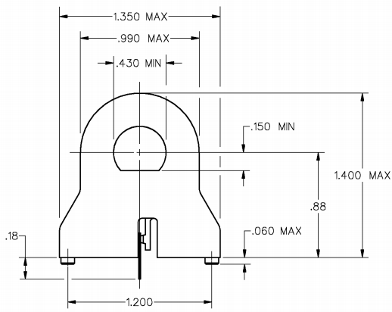
Notes:
If your design supports scaled drawings, system schematic or diagrams, use them. If not see the other image for process type image.

Slide 11
Rental Car
Rental car
It is very interesting and relevant to the topic
Dan Bowman faced many challenges as a pilot but managed to overcome
Redesigning the plane in the middle of the war was the biggest mistake here
I selected this story having read the story and observed the resilience of the pilot
Notes:
A sentence or two about the second story you selected.
A sentence or two about why you chose this story
Then have a paragraph or two about the story. Use the bullet points you made in the slide to tie it all together.

Slide 12
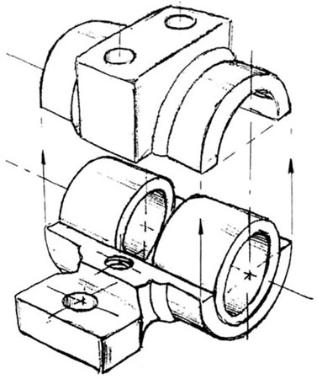
Use an Appropriate Title
What we now know is that…
There are several new technologies…
The body of scientific knowledge recently expanded providing new insight into …
Notes:
The research is related to my story because it is a about an error in technology but was successfully corrected

Slide 13
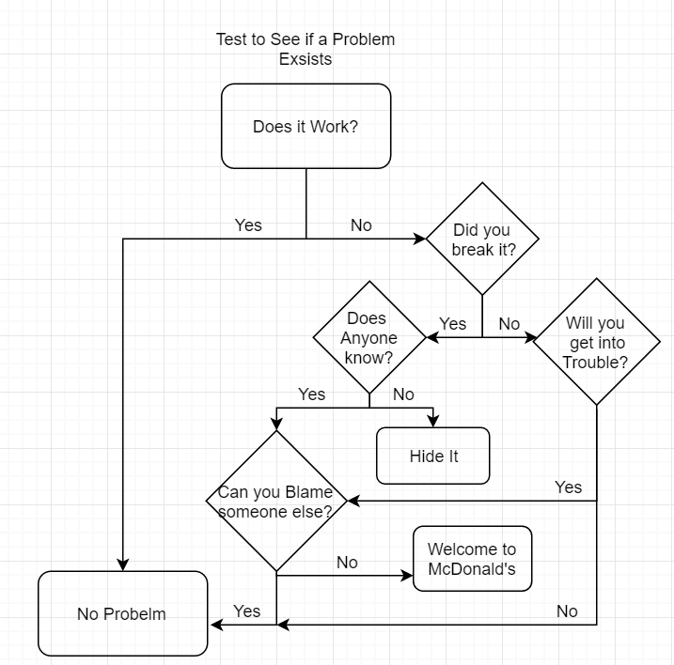
The process
Notes:
Here is the process I used to begin my design process. As you can see, I needed to start with problem identification then I could determine if a problem existed and the best approach to solving it. This is the most important step because….

Slide 14
Phase 0 Concept Evaluation
Make a list of initial thoughts
Include all possible solutions you might have had
Remember the lecture and think about the train and the mountain
Review the lecture/textbook material and tie it in here as well
Notes:
Discuss in great detail what your possible solutions could be. Brainstorming should be evident here as well as further potential research.

Slide 15
Phase 1 Planning and Specifications
Show a more realistic list of potential solutions here
Notes:
Consider all aspects of your proposed potential solutions. Include ethical theories and perspectives that would exclude some of you considerations
Include possible sources of error that would result in likely failures of some of the proposed solutions. Again this section should be highly detailed.

Slide 16
Phase 2 Development
Intensive training of pilots before they start working
Aviation schools to offer necessary and appropriate studies to avoid similar mistakes.
Only people who are clever and ready to learn should be allowed to enroll in this school of aviations
Notes:
Here you have narrowed the list down to plan and plan B. Discuss in detail, why these two are the best choices based on the pool of choices you had on the previous slide.

Slide 17
Phase 3 Test and Evaluation
List the testing procedures here.
List some details about the tests you would use
Notes:
Provide a detailed discussion about how you would test the design you have selected. What conditions would you test it in? For how long? And other considerations that apply to your design.

Slide 18
Phase 4 – Product Release
Create a slogan for your product
Include how you keep track of your solutions and ensure they are still working
Include a failure plan that in the event something is going wrong you will address the problem accordingly.

Slide 19
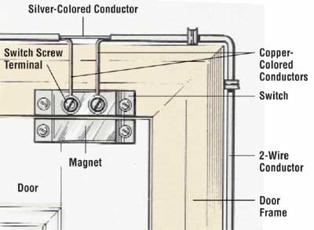
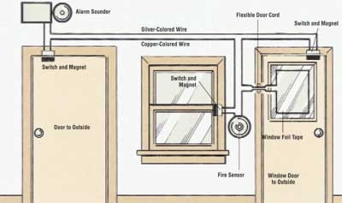
Notes:
If you cannot use a schematic, system or detailed design drawing, you can use something like this to show how it works.

Slide 20
Conclusion
Conclusion for Story 1
Conclusion for story 2
What was the problem you wanted to solve
What did others think was best
How did this impact your design process
What was your solution
How do you know it worked
What was the problem you wanted to solve
What did others think was best
How did this impact your design process
What was your solution
How do you know it worked
Notes:
Answer the questions in the slide here in the speaker notes. Separate each question and answer with numbers or bullet points in the speaker notes.

Slide 21
Final Thoughts
Conclusion Conclusion
Notes:
In this section you will need to identify future plans of the solutions. The goal here is continuous improvement. Statistics should be used as the evaluation to monitor the results of the solution. To see if the problem getting better or worse. You should also address the need to look for improved technologies, cost reduction and other ideas presented in the problem solving and statistics lectures.

Slide 22
References
References for Story 1
References for Story 2
Notes:
You do not need notes here, but be sure to use APA to list the sources you select!

